Slide 1
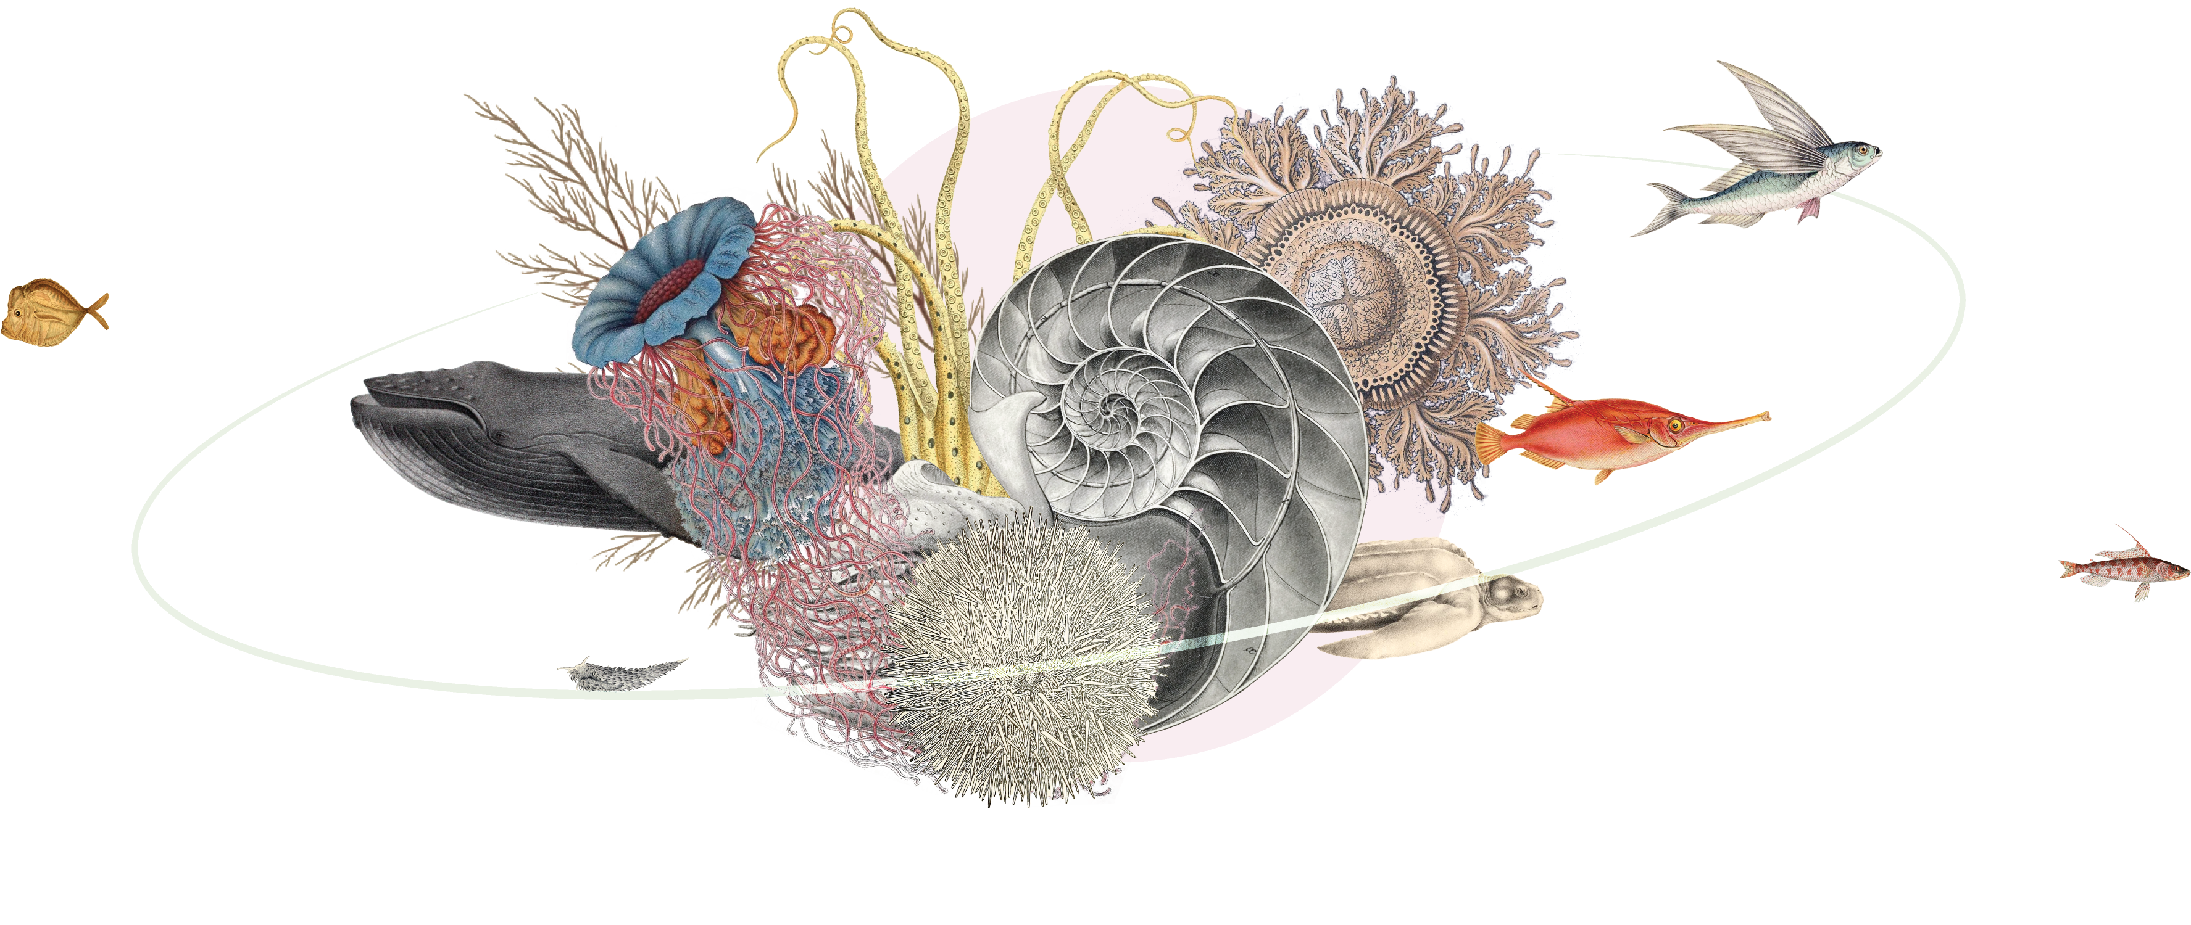
Marine
life
gbif.org/marine
Notes:
Text from postcard:
GBIF works with networks and organizations from around the world to assemble information on life both above and below the waves of our ocean planet, delivering the accessible, interoperable data needed to better understand, monitor, protect and restore coastal and marine biodiversity

Slide 2
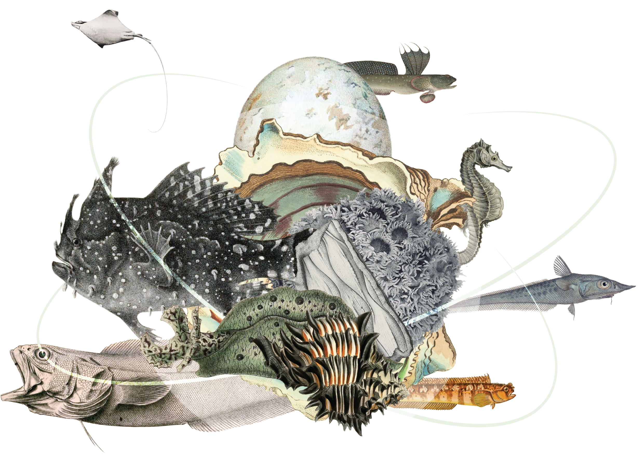
Marine life
GBIF and OBIS remain committed to exchanging data, knowledge and skills between their networks and improving the usability, interoperability and overall fitness-for-use of FAIR and open data on marine biodiversity available through both infrastructures.
gbif.org/marine
Notes:
Notes

Slide 3
Marine life
GBIF and its primary marine partner, the Ocean Biodiversity Information System (OBIS), work alongside other networks and organizations around the world to assemble information on life both above and below the waves.
Together, we aim to deliver the most comprehensive, freely accessible and fully interoperable data needed to understand, monitor, protect and restore coastal and marine biodiversity of our shared ocean planet.
gbif.org/marine

Slide 4
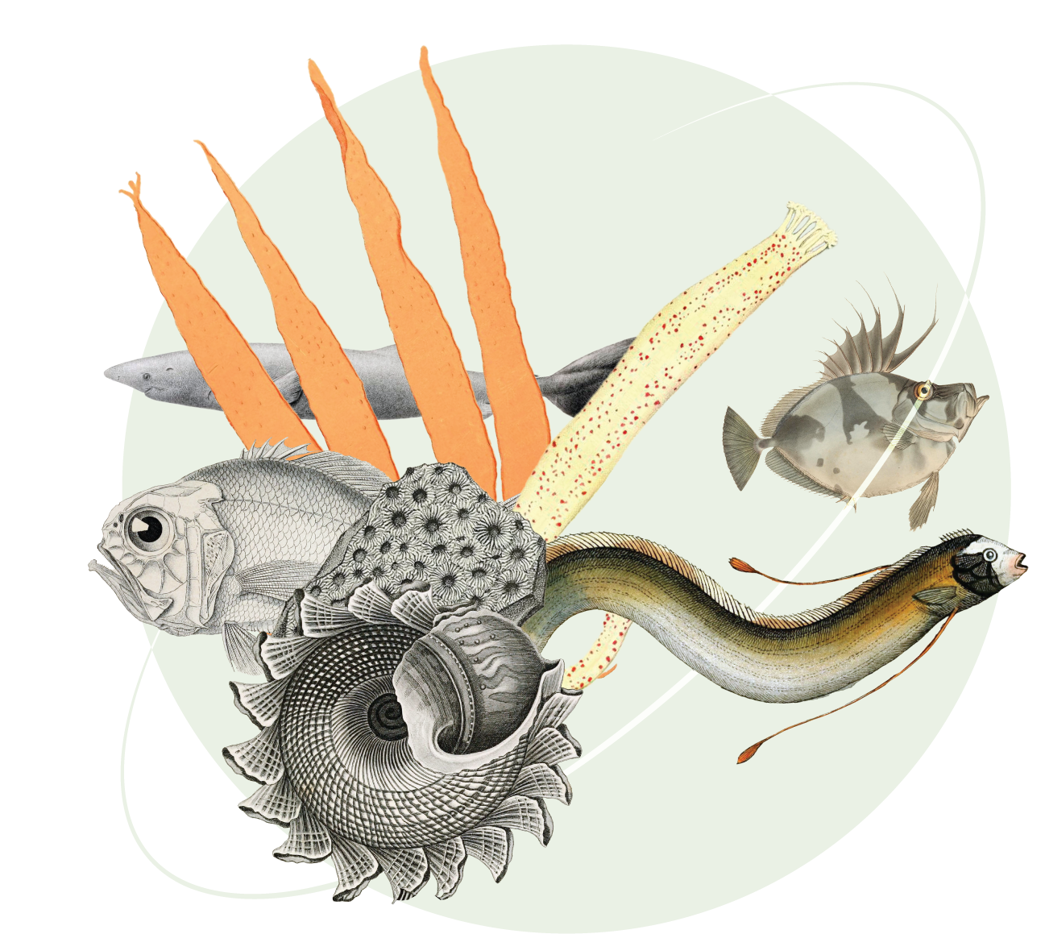
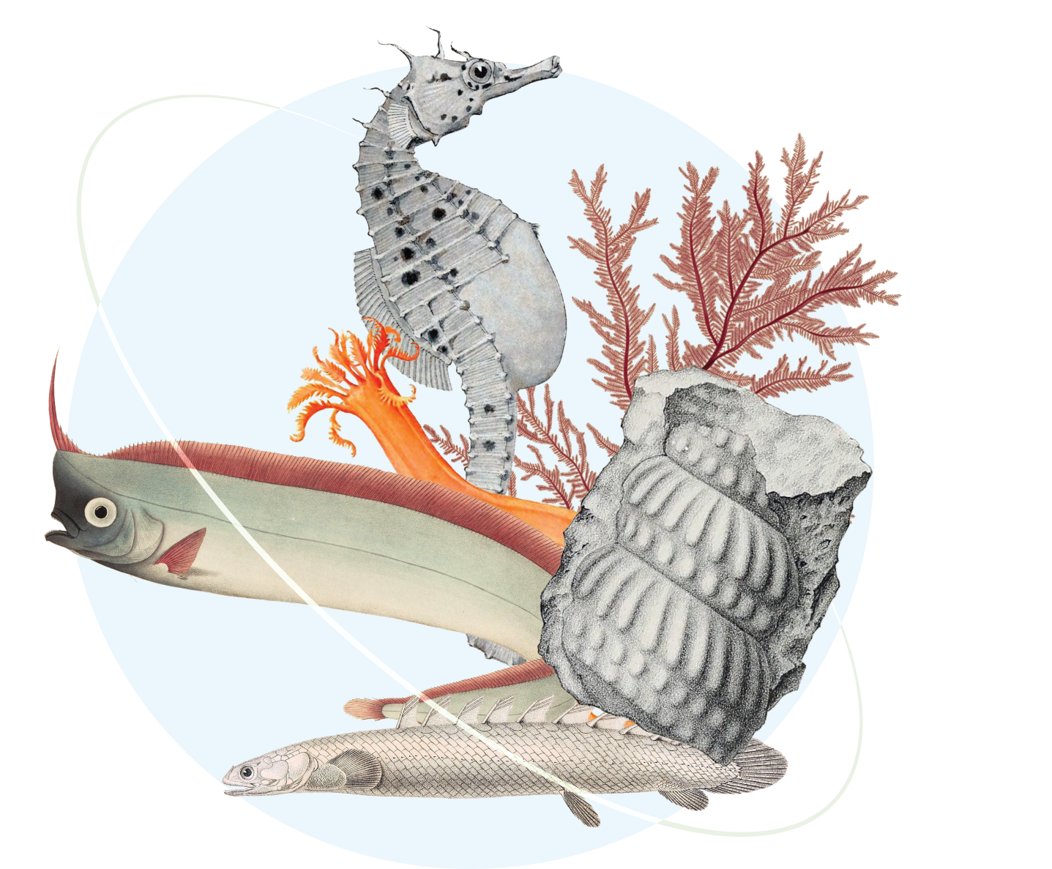
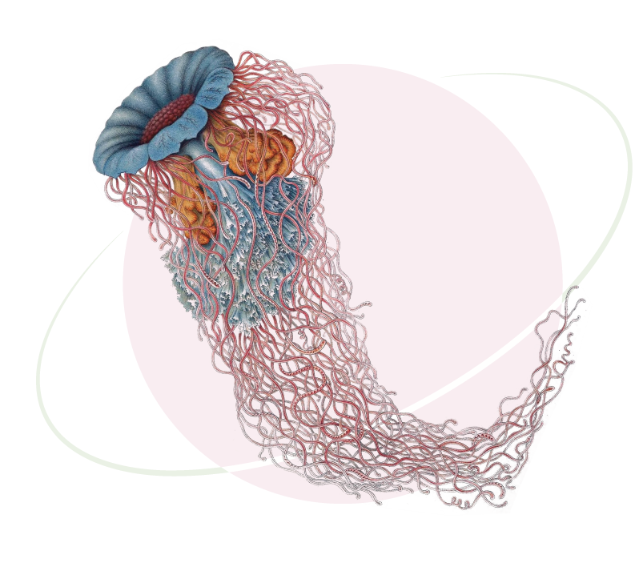
OBIS & GBIF
OBIS-GBIF Joint Strategy for Marine Biodiversity Data
OBIS-GBIF 2024 Action Plan on Marine Biodiversity Data
GBIF-OBIS Joint strategy and action plan webinar recordings
gbif.org/marine

Slide 5
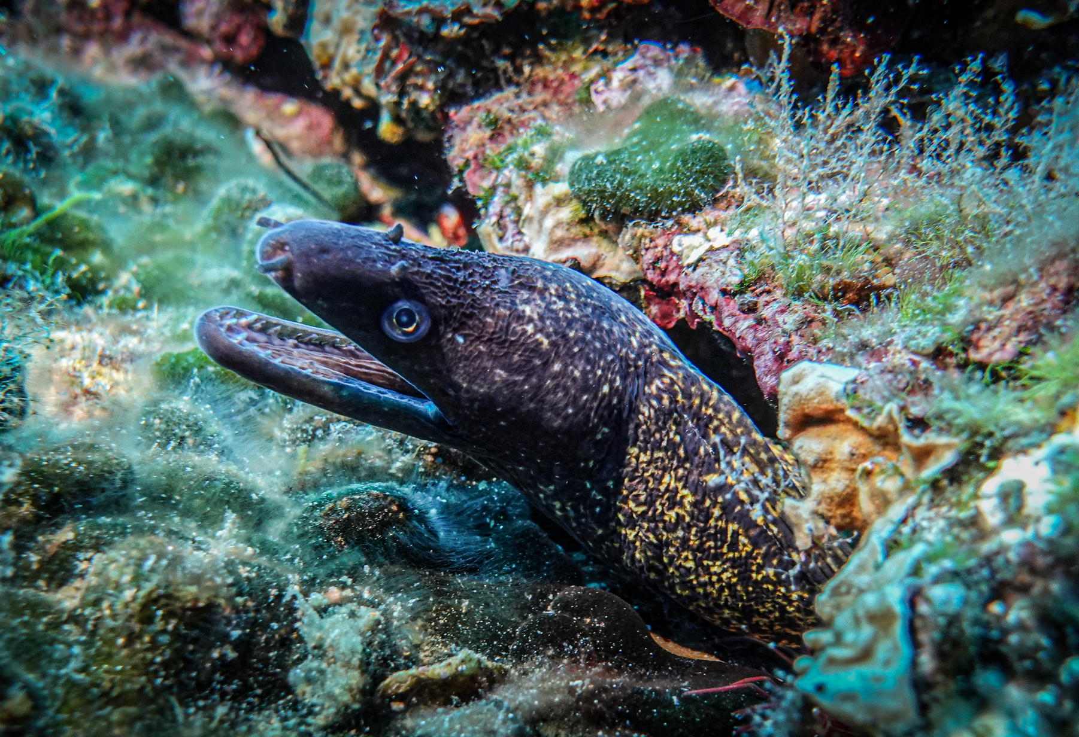
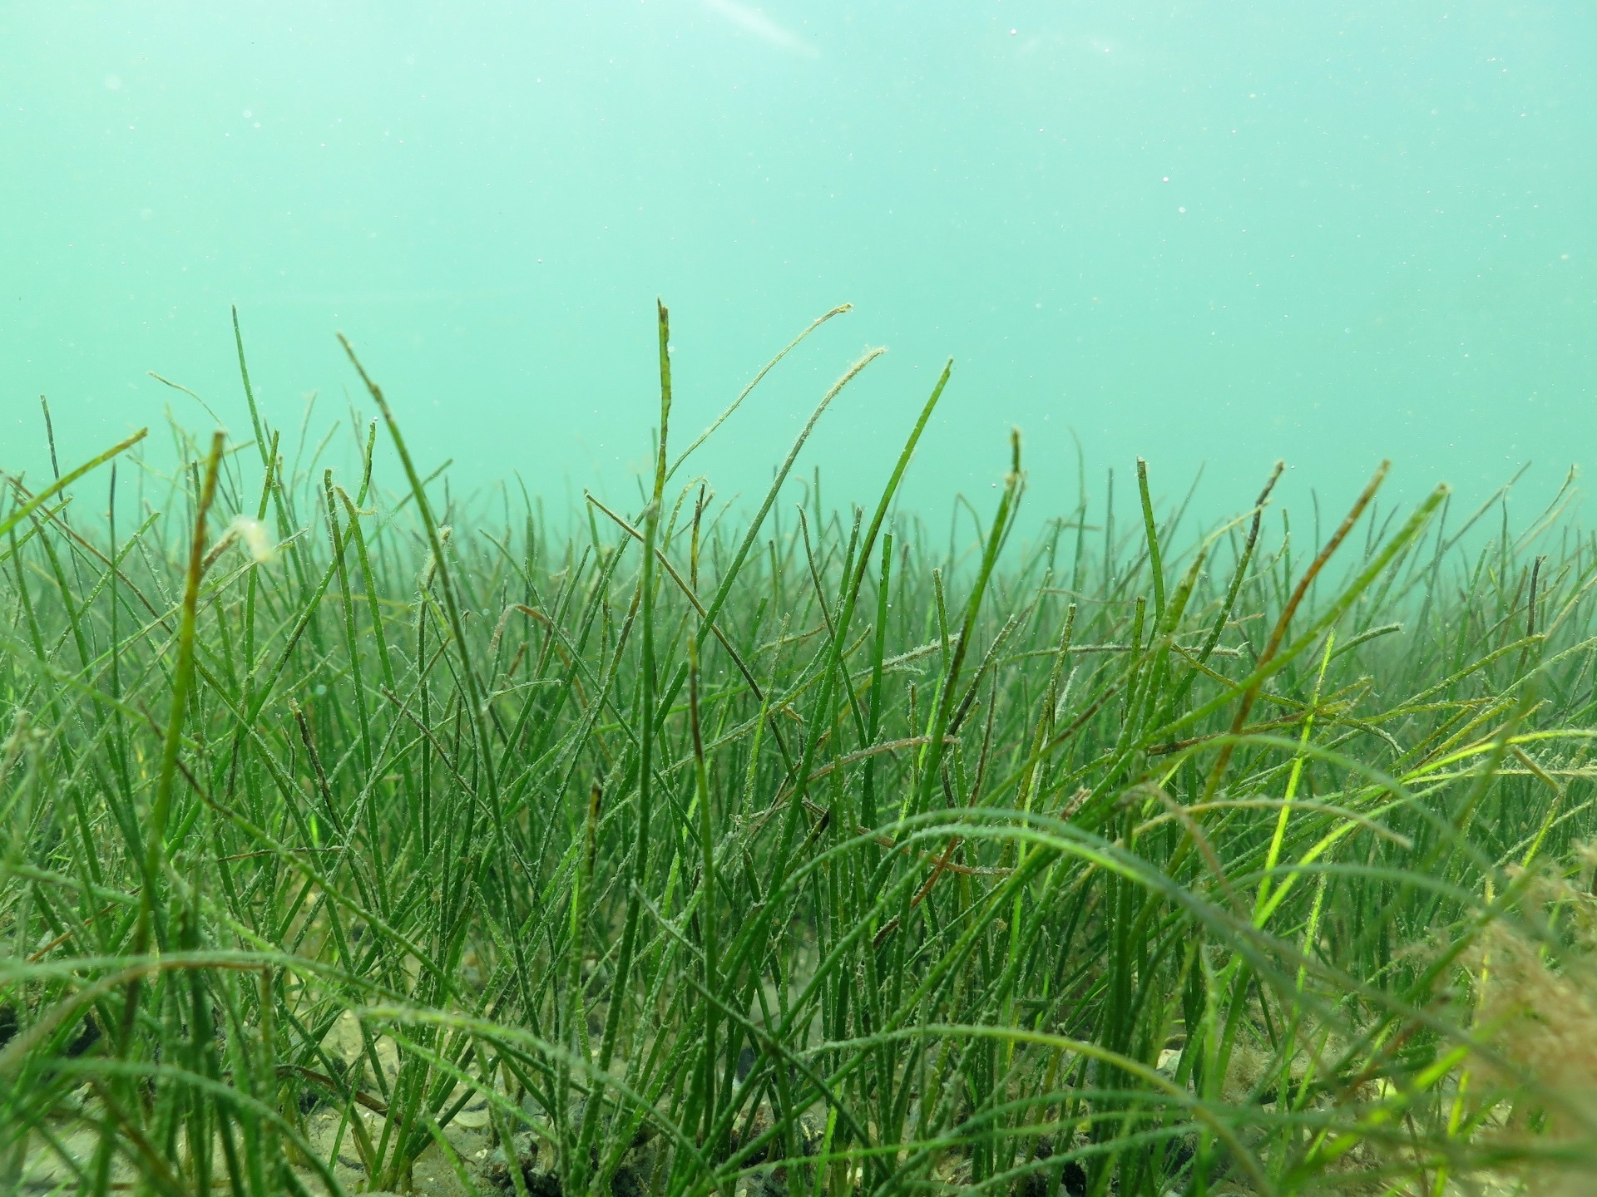
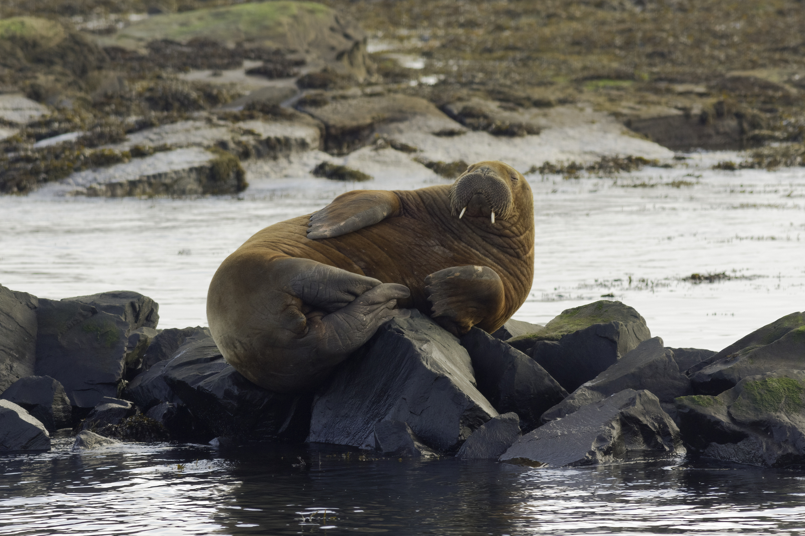
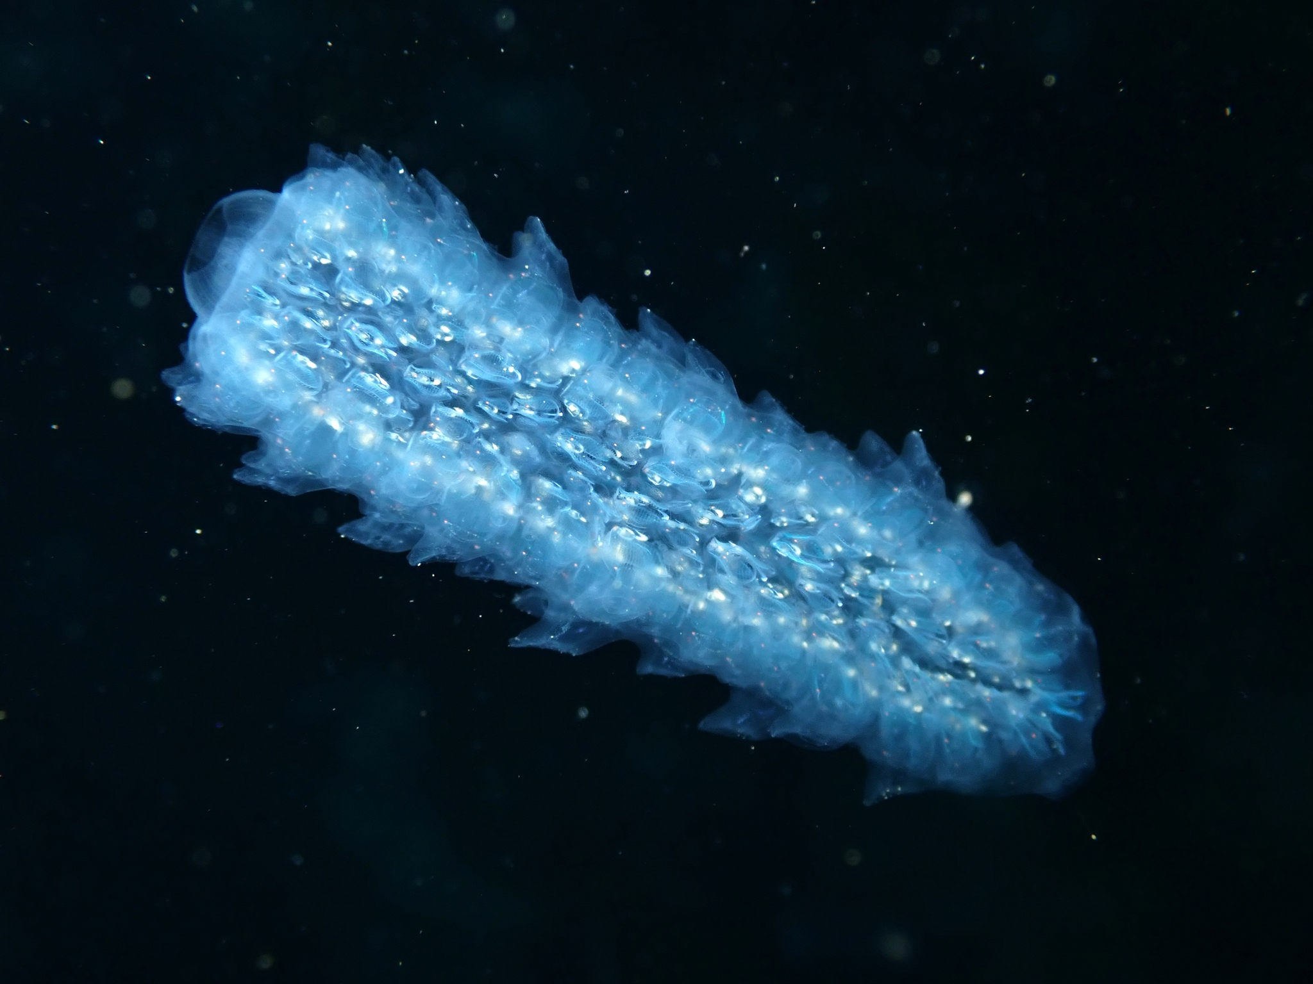
Featured data uses about marine biodiversity
Enhancing marine biodiversity data collection using commercial ferry network
Tropical seagrass dispersal: active or passive?
Increasing vagrancy of Atlantic walruses in temperate Europe
Global synthesis of knowledge on pyrosomes
https://www.gbif.org/resource/search?q=marine&contentType=dataUse&topics=MARINE
Notes:
Notes

Slide 6
Marine life
Learn more!
gbif.org/marine

